Slide 1
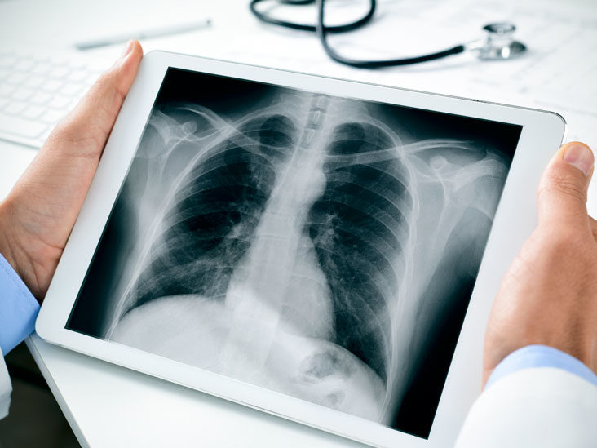

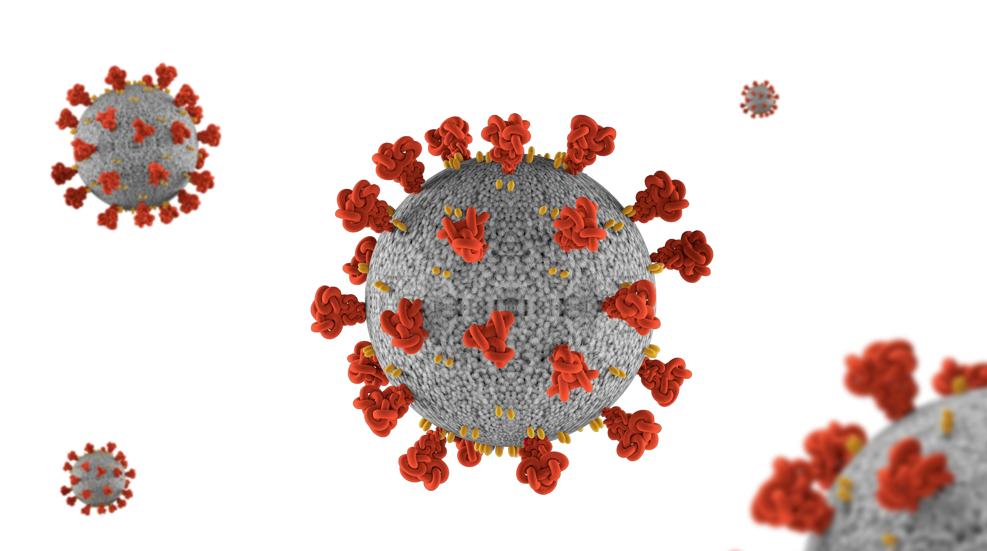
XRay Image Classification for COVID-19

Slide 2
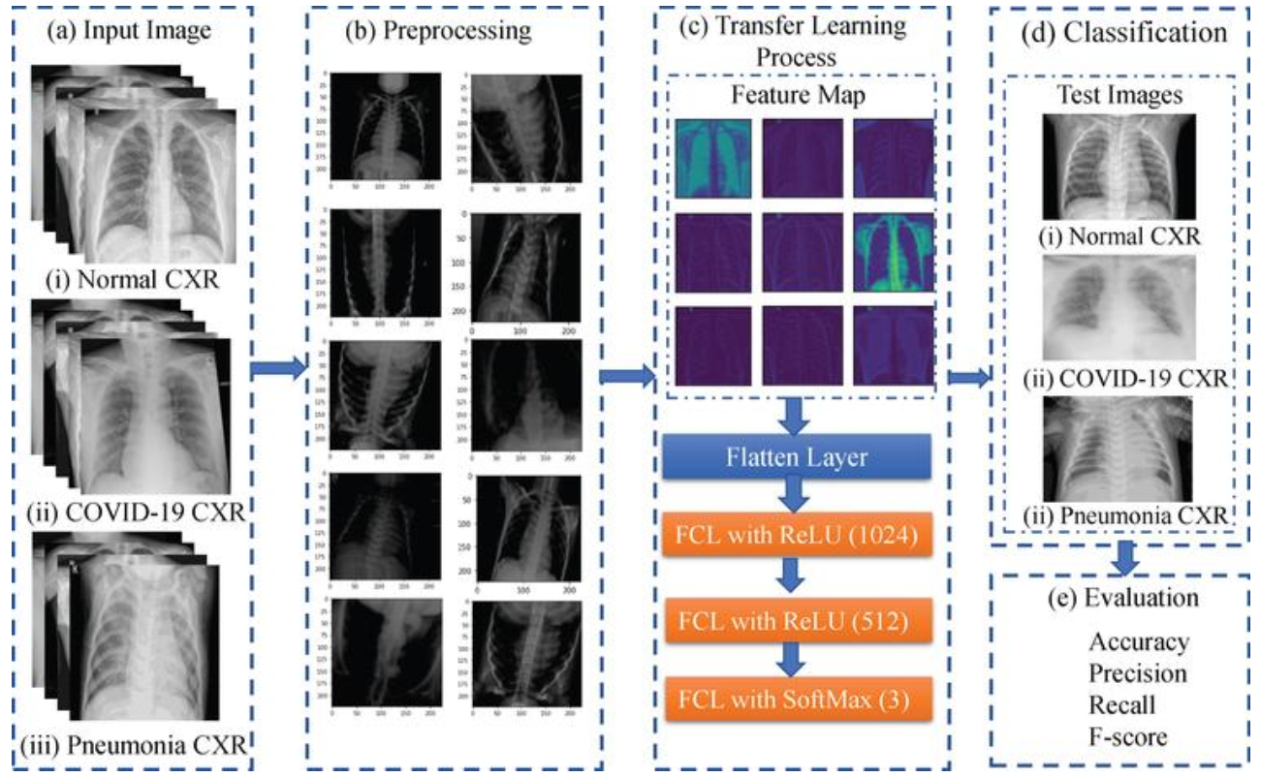
Using Convolutional Neural Networks

Slide 3
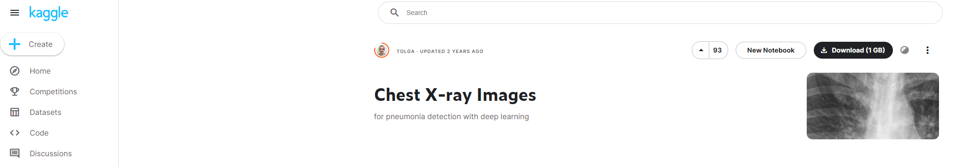
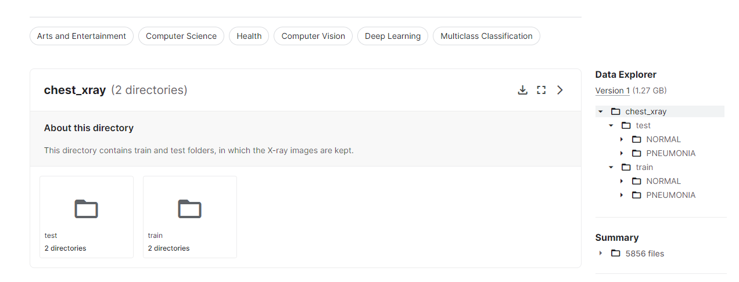
Images are taken from Kaggle

Slide 4
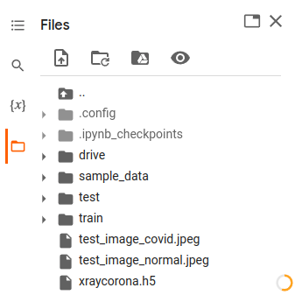
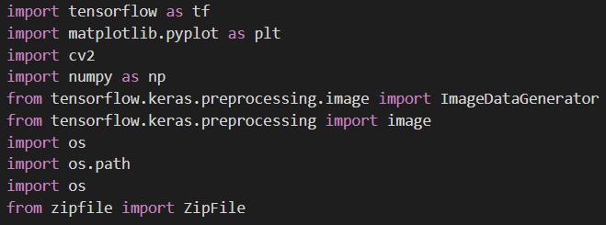
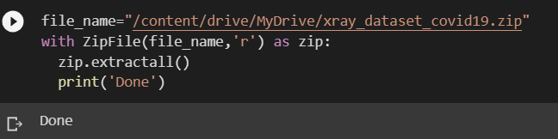
IMPORTING NEEDED LIBRARIES

Slide 5
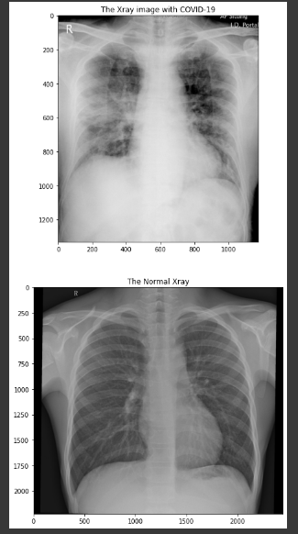
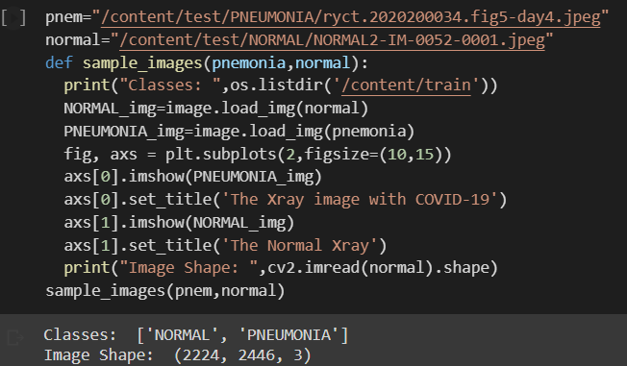
Then we decided to write a function to print out some samples from each class of images. We used load_img to print image. Then we used subplots to print it in one place. And we printed its shape as well you may check there.

Slide 6
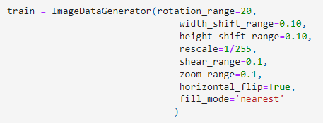
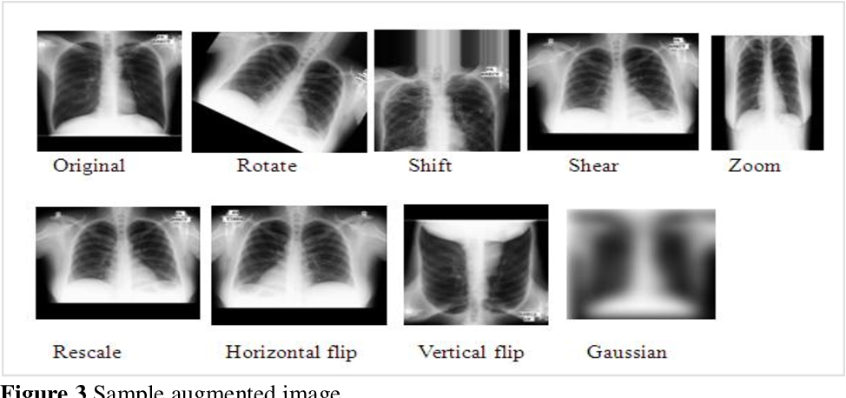
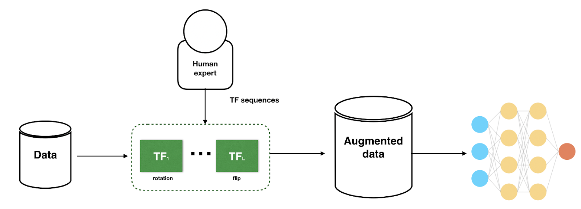
Data augmentation

Slide 7
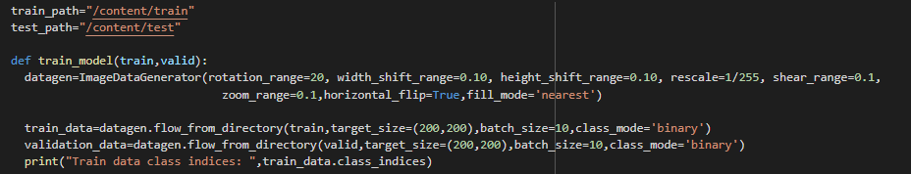

Slide 8
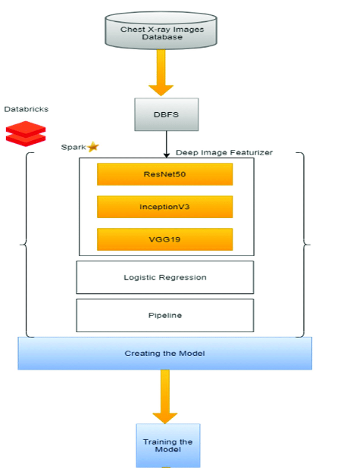
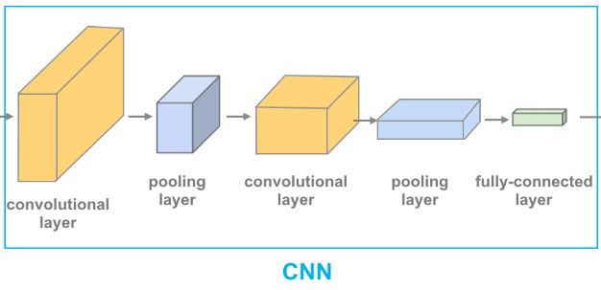
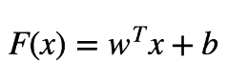
Give the weights of cnn to Linear regression .
CNN
MaxPooling.

Slide 9
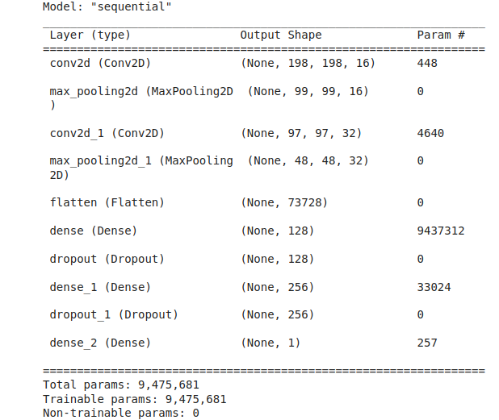
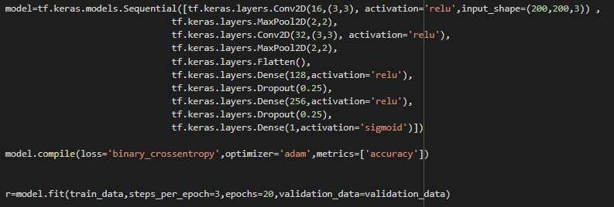
Here, we used sigmoid at the end, so it is binary. That is why it should be sigmoid function.

Slide 10
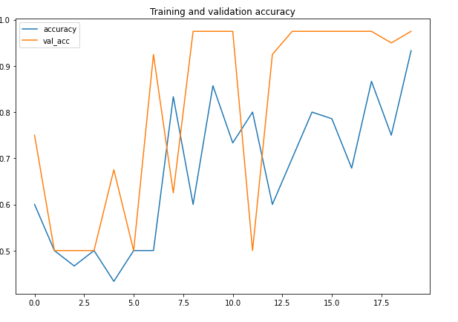
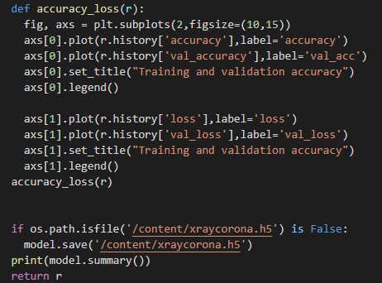
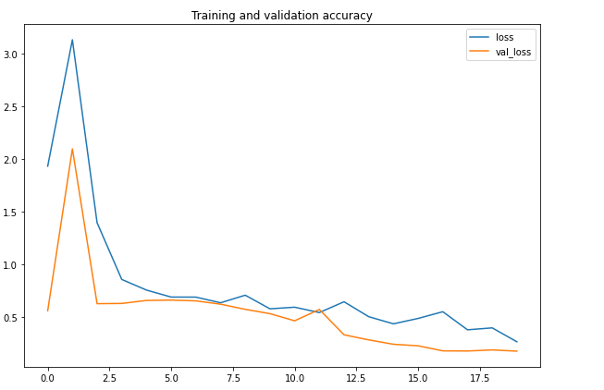
Once training is done we may see the plots for accuracy and losses. It is written with subplots. Then We saved the model as h5. It saves the model with all weights. Here it is.

Slide 11
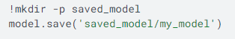

-Once we finish train We do not have to forget to save the model. -Because training takes lots of time, so we save the best epoch result.
Anyo one can take the model and use, it is saved with its weights.

Slide 12

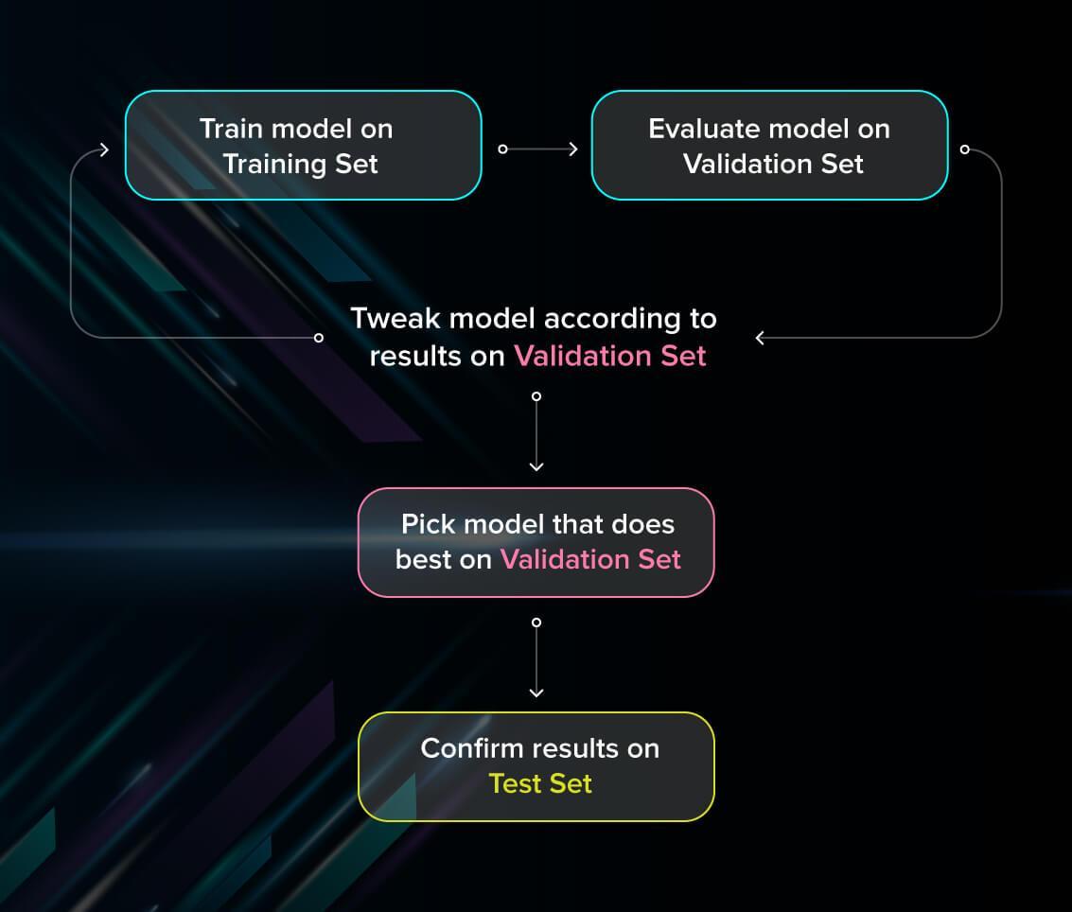
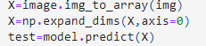
TESTING
-We do some preprocessingof the image. We will convert it to correct size that model accepts.
-Give the image with “model.predict” method.
-We get the images with the labels that we used in out data preprocessing for training.

Slide 13
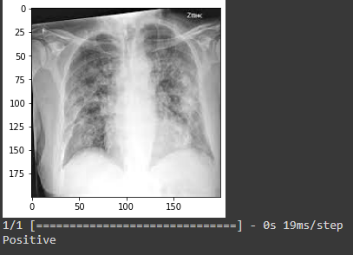
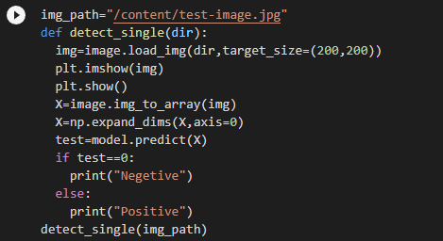
TESTING.

Slide 14




What I will be using...

